Slide 1
Salesforce Reports Dashboard

Slide 2
Objective
At the end of the session, you will be able to:
Create Custom Report Type
Understand what is Report and dashboard
Create new Dashboard

Slide 3
Reports
Reports are of two types
Standard report
Normal reports which gives you the detail analysis of account, contact, opportunity like objects
Can be modified to create custom reports
May not be deleted but folder can be hidden
Need to save in a standard folder
Can not use report search functionality to search standard report
Custom Reports
Salesforce.com comes with a huge menu of useful reports, and yet they might not be exactly what you're looking
if your company has added custom fields on the account record that are unique to your customer, a standard New Accounts report doesn't show you all the information you want to see on recent accounts.
May be edited or deleted
May not be saved in a standard folder
Can be searched for in custom report search

Slide 4
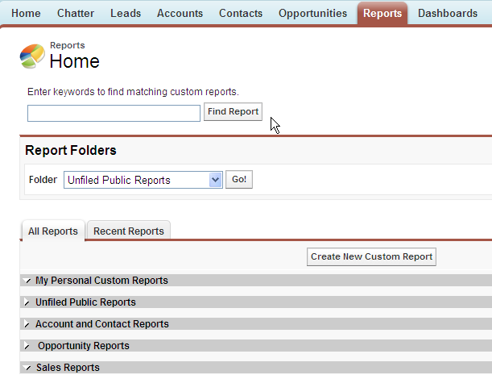
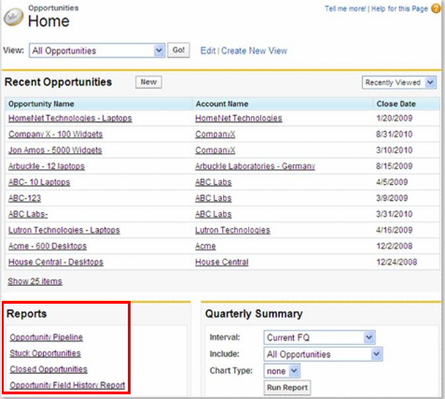
Reports Navigation
You can see the reports in Report tab and bottom of every object home page

Slide 5
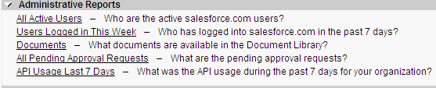
Administrative reports
Click Path : Report | Home
The All Active Users report lists the active users in your organization and when they last logged in.
The Users Logged in This Week report lists all of the users who have logged in to Salesforce in the past seven days.
The Documents report lists the documents within each document folder.
The All Pending Approval Requests report lists the approval requests awaiting approval for each approval process
API Usage Last 7 Days report list APIs usage during last 7 days for your organization

Slide 6
Report Type
Summery Report
Matrix Report
Tabular Report

Slide 7
Tabular Report
Simple table with rows and columns
It present data in simple rows and columns, much like a spreadsheet.
They don't contain groupings, but can be used to show column summaries, like sum, average, maximum, and minimum.
Enable floating report header property (available only with tabular report) TRUE to float header as scroll down the report
Click Path : Setup | customize | Reports & Dashboards | User Interface Settings
.

Slide 8
Summery Report
.
Simple table with rows and columns data with totaling and subtotaling of data
Display numbers as subtotal and total

Slide 9
Matrix Report
.
Summarizes data in a grid against horizontal and vertical criteria
Provide total for rows and columns
Is used for comparing groups

Slide 10
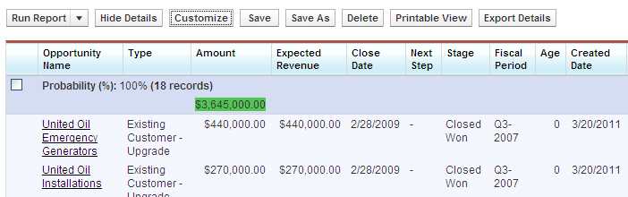
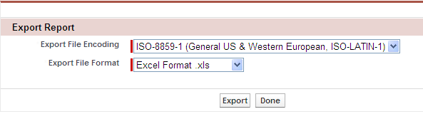
Report Options
Click on Customize button to customize the report and save it again
Click Export Details to export report to specific destination.
You can export upto 256 columns and 65536 rows of data

Slide 11
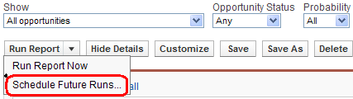
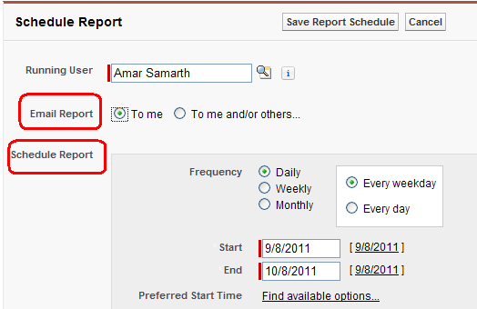
Report Options- Scheduling and Emailing Report

Slide 12
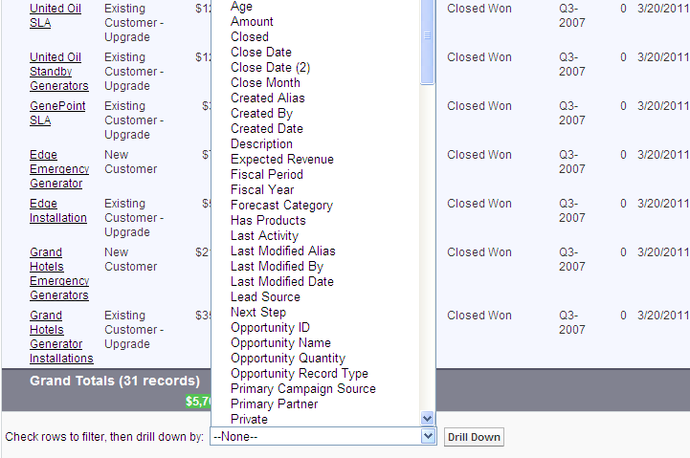
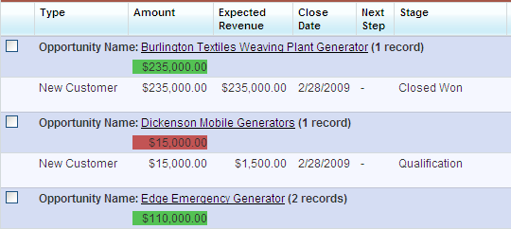
Report Options
Filter and drill down on field by selecting fields from drop down

Slide 13
Dashboard
Visual representation of key business information
Show information from multiple reports
Refresh can be schedule
Can email a dashboard
Running user determines the level of access to the dashboard data
Running user determines what data is displayed on dashboard

Slide 14
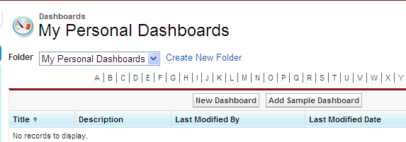
Dashboard Navigation
You can see the existing dashboards or create the new one using Dashboard tab

Slide 15
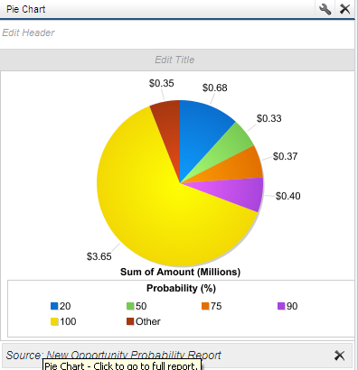
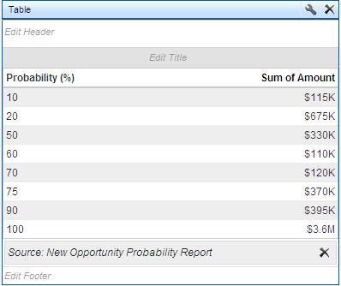
Dashboard Components
Table
Data in the form of row and columns
Can have max 4 columns
Chart
Graphical representation of
report result

Slide 16
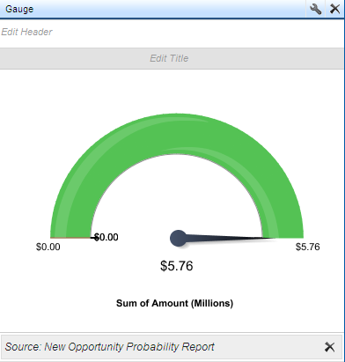
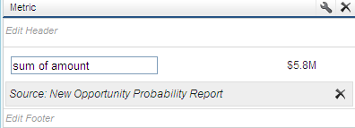
Dashboard Components
Metric
A single data value drawn from the grand total of report
Gauge
A single data value displayed as a point on a defined spectrum, drawn from grand total of report

Slide 17
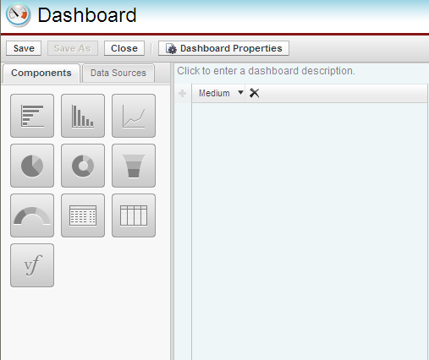
Steps to create new Dashboard
Click path : Dashboard | Click on New Dashboard button
Add components to your dashboard

Slide 18
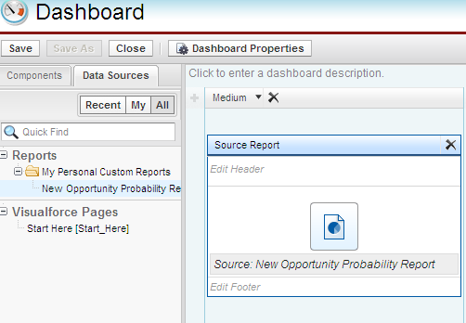
Steps to create new Dashboard
3) Choose the data source for component

Slide 19
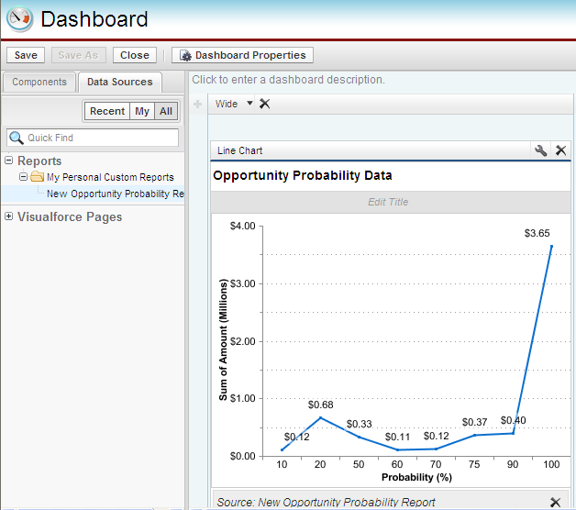
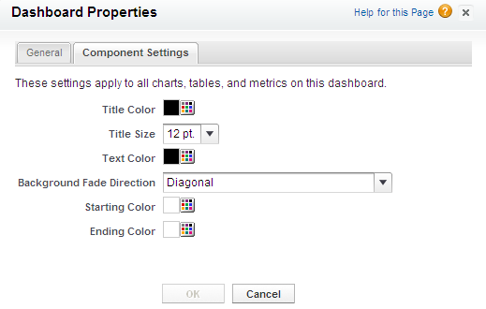
Steps to create new Dashboard
Organize the dashboard
Reorder
Resize components
Edit header, titles and footers
Edit Attributes
Edit Dashboard properties
Edit Header

Slide 20
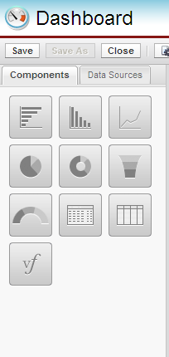
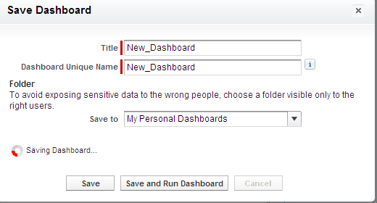
Steps to create new Dashboard
Click on save to save the dashboard

Slide 21
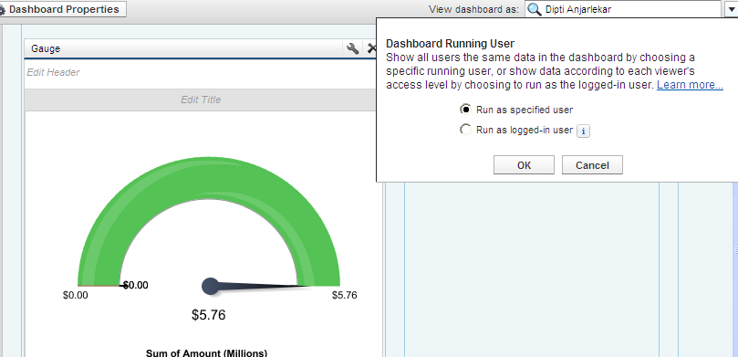
Dashboard Options
No need to create multiple dashboards for different users
Allows you to create a single dashboard on which each user will see only data they have assess to
Preview the dashboard as different users will see it

Slide 22
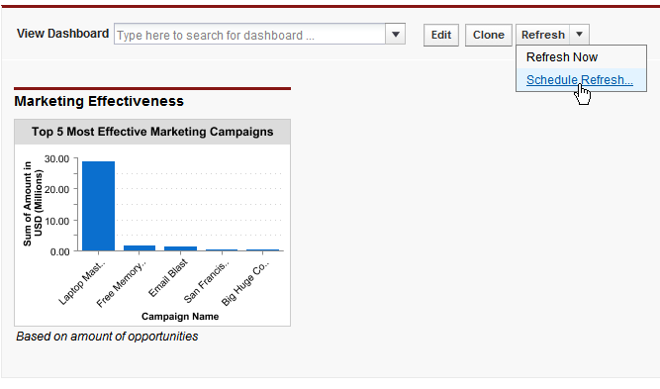
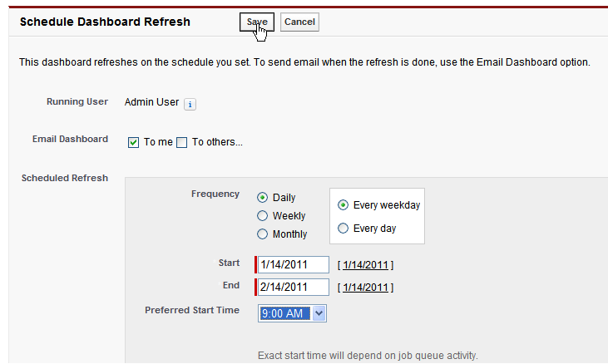
Dashboard Options
You can refresh the dashboard at scheduled time

Slide 23
Summary
This module showed you
How to Create Custom Report Type
what is dashboard
How to Create new Dashboard

Slide 24
Thank you

